Slide 1
  Programming 6
Workshop on CMake
johan.korten@han.nl
V1.0 Nov 2025

Slide 2
Workshop Topics overview
Clean code (beyond SOLID)
CMake
Unit testing
Commentaar
Patterns (Clean architecture)

Slide 3
Workshop Topics for Today
- Testing in General
- V-Model vs Testing Pyramid

Slide 4
General Warning on Testing
“Program testing can be used to show the presence of bugs,
but never to show their absence!”
― Edsger W. Dijkstra

Slide 5
General Warning on Testing
“Program testing can be used to show the presence of bugs,
but never to show their absence!”
― Edsger W. Dijkstra
- Testing is inherently incomplete.
- You can run a million tests and still miss the one input that breaks everything.
- Tests prove "this scenario works," not "all scenarios work."

Slide 6
Testing Focus
- V-model = what and when (traceability to requirements, phase gates)
- Pyramid = how many (economics of test distribution)
- Both agree: unit tests are the foundation
Essential for e.g. medical device development (IEC 62304) or automotive (ISO 26262)

Slide 7
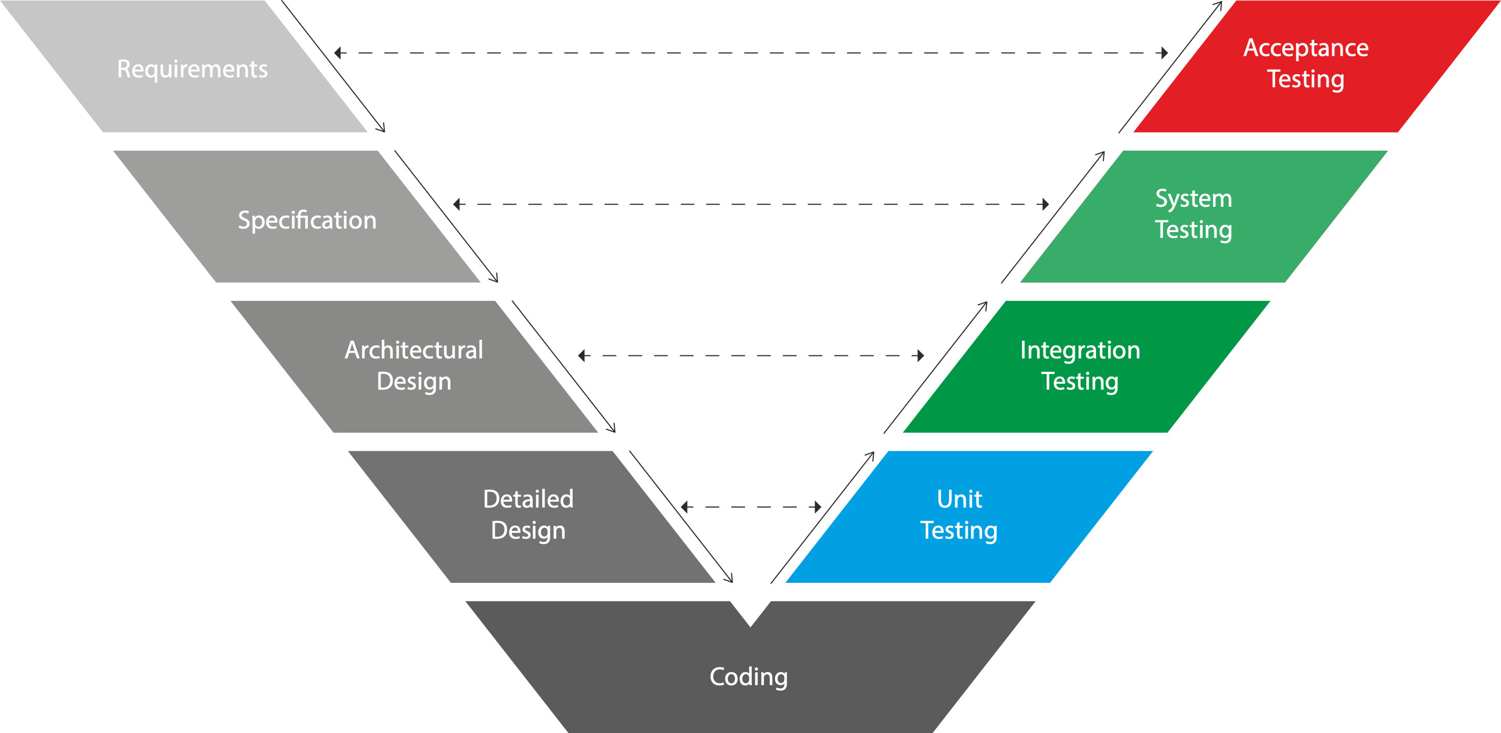
V-Model

Slide 8
V-Model: Acceptance Test
- Validation
- With real users/environment

Slide 9
V-Model: System Test
- Hardware + Software
- Real target, real peripherals

Slide 10
V-Model: Integration Testing
Software Integration:
- Simulated Hardware
Hardware Integration:
- Board Bring-up

Slide 11
Unit Testing
Software Unit Testing:
- Today’s Main Topic
Hardware Unit Testing:
- Component Test

Slide 12
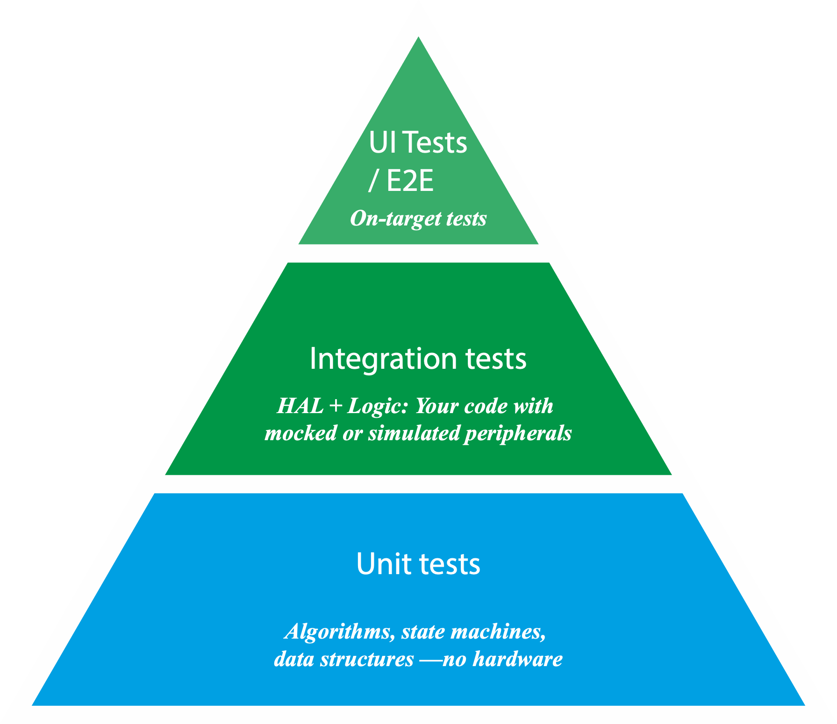
Testing Pyramid vs. V-Model

Slide 13
Testing versus Verification
Computer Science Theorists (Dijkstra formalized this) prefer Verification over Testing, but:
- Formal verification is expensive and limited in scope
- Testing catches many bugs cheaply
Approach | Proves | Cost
Formal verification | Correctness (for specific properties) | Very high
Unit tests | Stops execution entirely—timing-sensitive code breaks | Low
Integration/system tests | Changes memory layout, stack usage, cache behavior | Medium
No testing | Nothing | Zero (until production fails)

Slide 14
Testing Pyramid vs. V-Model

Slide 15
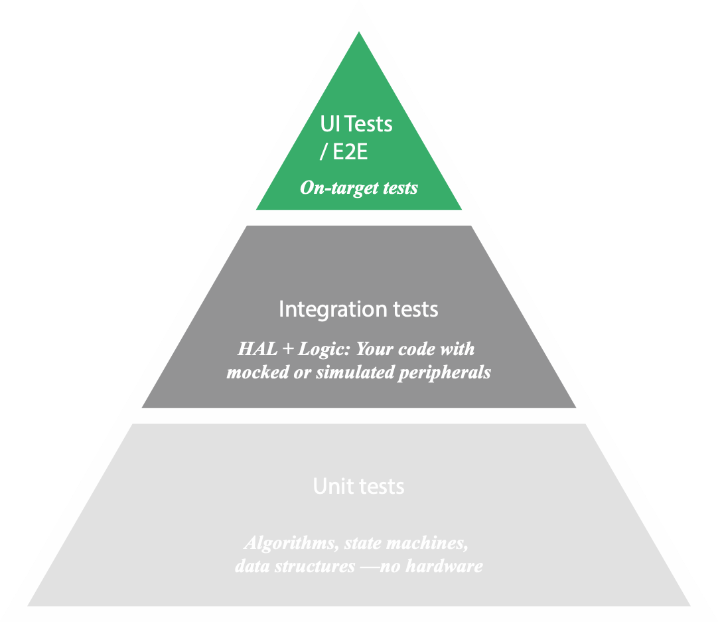
UI / End-to-end / Hardware tests (top, fewest tests)
- Real target, real peripherals
- Slow, expensive, sometimes flaky
- Essential but not where you want to catch bugs

Slide 16
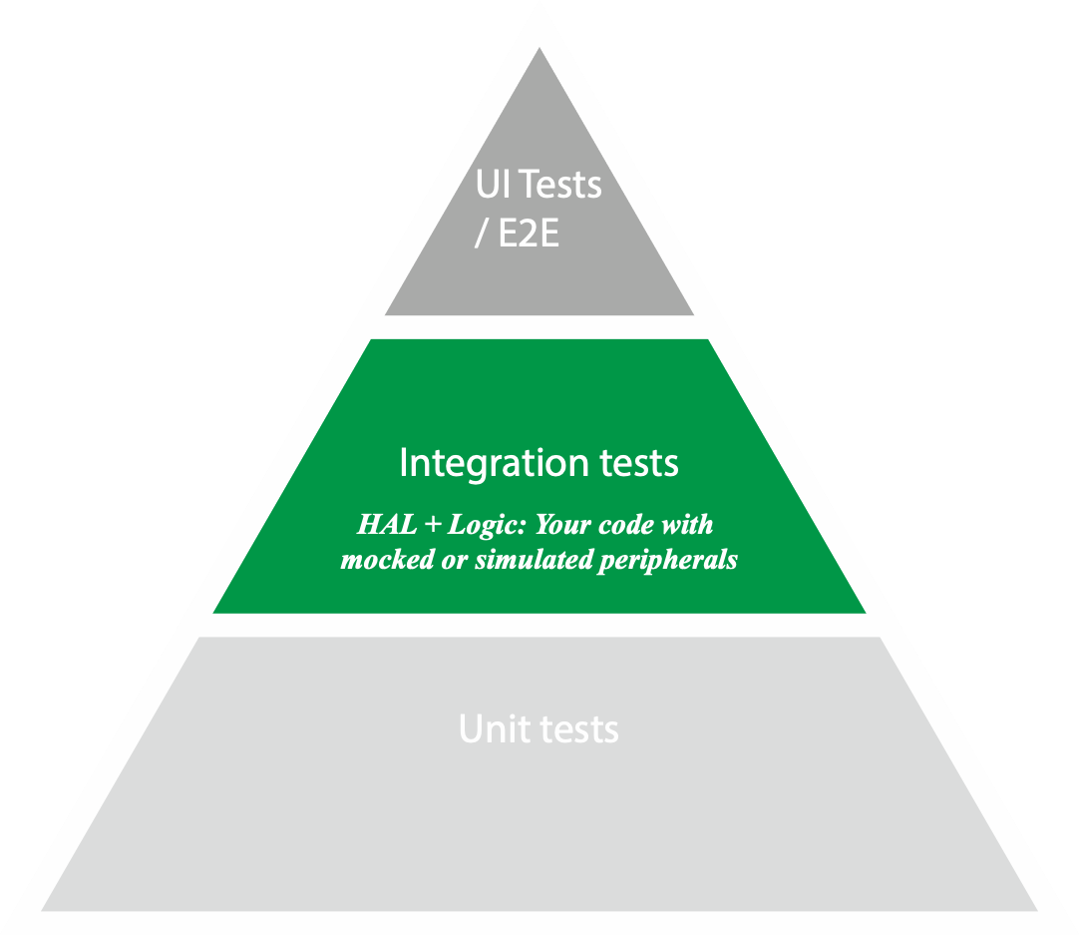
Integration tests (middle)
- Test interactions between components
- May include HAL with simulated peripherals
- Slower, but still on PC or emulator

Slide 17
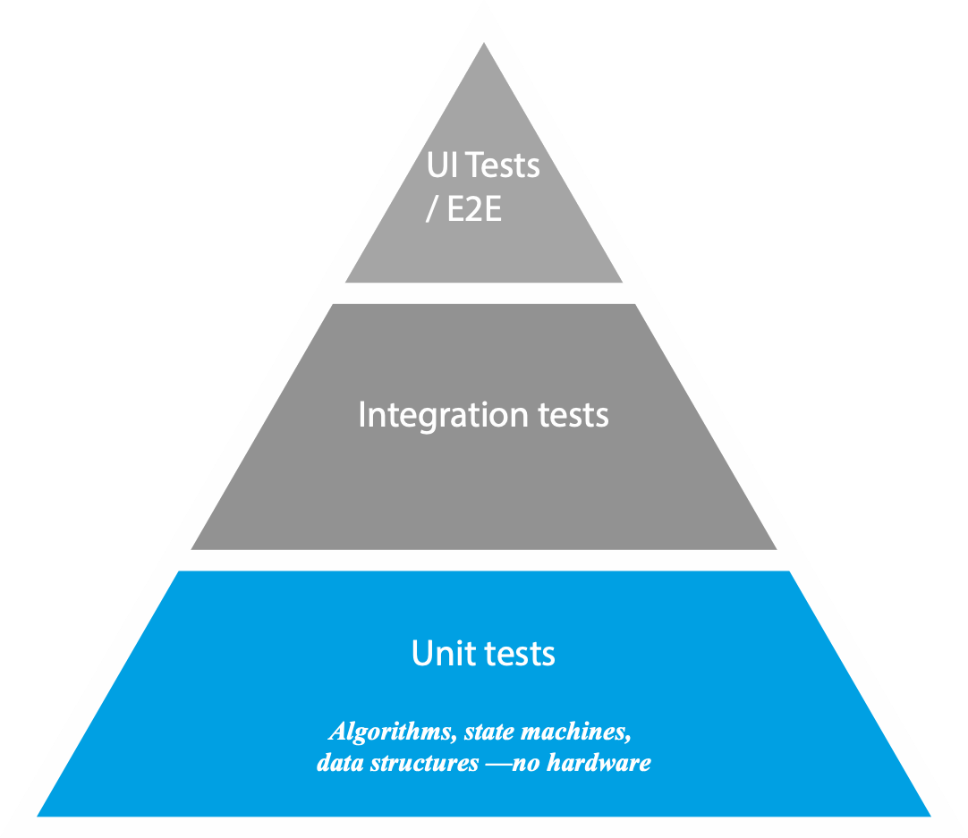
Unit tests (base, most tests)
- Fast: milliseconds per test
- Cheap: no hardware needed
- Precise: failures pinpoint the problem
- Stable: no flaky hardware timing issues

Slide 18
Unit Testing

Slide 19
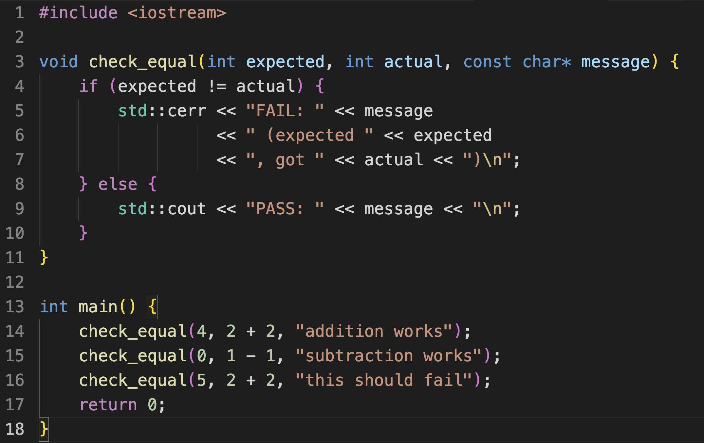
Basic Unit Test mechanics

Slide 20
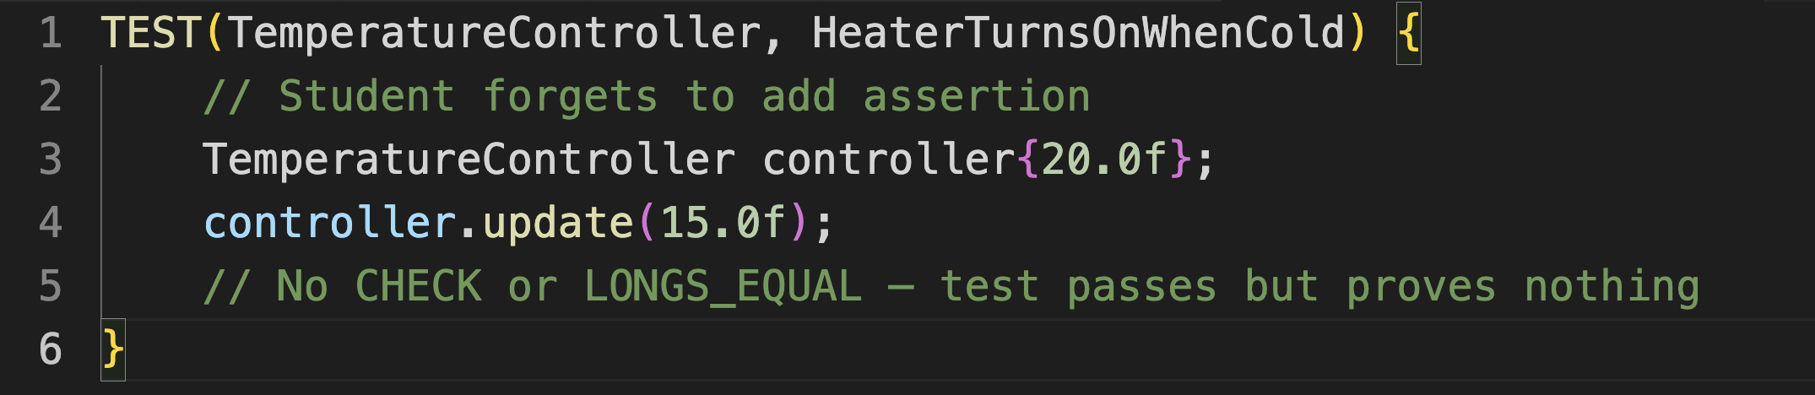
Tests that can’t fail…
No Asserts

Slide 21
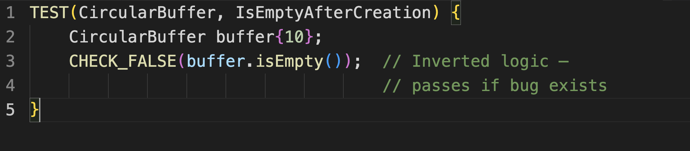
Tests that can’t fail…
Tautology

Slide 22
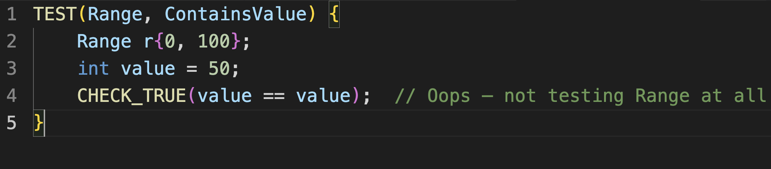
Tests that can’t fail…
Wrong assertion

Slide 23
C++ Unit Testing Frameworks
Framework | Style | Embedded Suitability | Notes
Catch2 | Modern, header-heavy | Good | Nice syntax, no macros for test registration, slow compile
GoogleTest | Full-featured | Good | Industry standard, mature, more setup
doctest | Lightweight Catch2 | Excellent | Fastest compile, minimal footprint, Catch2-like syntax
Unity | Pure C | Excellent | ThrowTheSwitch, tiny, runs anywhere
CppUTest | Embedded-focused | Excellent | Made for embedded, James Grenning's book uses it
µTest | Minimal | Excellent | Header-only, tiny

Slide 24
CppUTest
- Purpose-built for embedded
- James Grenning's Test-Driven Development for Embedded C uses it
- Better memory leak detection out of the box
- More C-friendly if they mix C and C++
- Has CppUMock built in

Slide 25

Please pull the repo
https://github.com/AEAEmbedded/ESE_PROG/tree/main/Workshops/UnitTesting
https://github.com/AEAEmbedded/ESE_PROG.git

Slide 26
MinimalTest using CppUTest
Case 0
MinimalTest
├── CMakeLists.txt
├── main.cpp
└── test_first.cpp

Slide 27
MinimalTest using CppUTest
Case 0
- main.cpp
#include "CppUTest/CommandLineTestRunner.h"
int main(int argc, char** argv) {
return CommandLineTestRunner::RunAllTests(argc, argv);
}

Slide 28
MinimalTest using CppUTest
Case 0
- CMake to fetch CppUTest
# Fetch CppUTest
include(FetchContent)
FetchContent_Declare(
CppUTest
GIT_REPOSITORY https://github.com/cpputest/cpputest.git
GIT_TAG master
)

Slide 29
MinimalTest using CppUTest
Case 0
- test_first.cpp
#include "CppUTest/TestHarness.h"
TEST_GROUP(FirstTest) {
};
TEST(FirstTest, TrueIsTrue) {
CHECK_TRUE(true);
}
TEST(FirstTest, OnePlusOneIsTwo) {
LONGS_EQUAL(2, 1 + 1);
}
Notes:
cmake -B build
cmake --build build
./build/first_test

Slide 30
TemperatureTest using CppUTest
Case 1
TemperatureTest/
├── CMakeLists.txt
├── temperature_sensor.hpp
├── temperature_sensor.cpp
├── test_temperature_sensor.cpp
└── main.cpp
Notes:
cmake -B build
cmake --build build
./build/test_temperature_conversion

Slide 31
TemperatureTestComplex using CppUTest
Case 3
- Test stateful classes using CppUTest's `TEST_GROUP` with `setup()` and `teardown()`.
TemperatureTestComplex/
├── CMakeLists.txt
├── temperature_filter.hpp
├── test_temperature_filter.cpp
└── main.cpp
Notes:
cmake -B build
cmake --build build
./build/test_temperature_filter

Slide 32
TemperatureTestMocking using CppUTest
Case 4
TemperatureTestMocking/
├── CMakeLists.txt
├── i_temperature_sensor.hpp
├── i_heater.hpp
├── temperature_controller.hpp
├── temperature_controller.cpp
├── mock_temperature_sensor.hpp
├── mock_heater.hpp
├── test_temperature_controller.cpp
└── main.cpp
- Mocking / Dependency injection (more on Patterns week after next week)
Notes:
cmake -B build
cmake --build build
./build/test_temperature_filter

Slide 33
Unit tests (base, most tests)
- Fast: milliseconds per test
- Cheap: no hardware needed
- Precise: failures pinpoint the problem
- Stable: no flaky hardware timing issues

Slide 34
Isolation versus Integration
Notes:
https://martinfowler.com/bliki/UnitTest.html

Slide 35
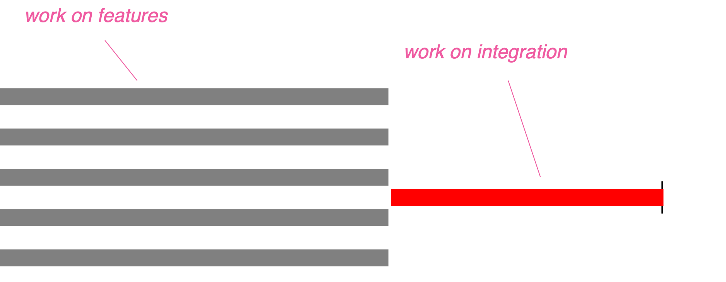
Continuous Integration
Notes:
https://martinfowler.com/bliki/UnitTest.html

Slide 36
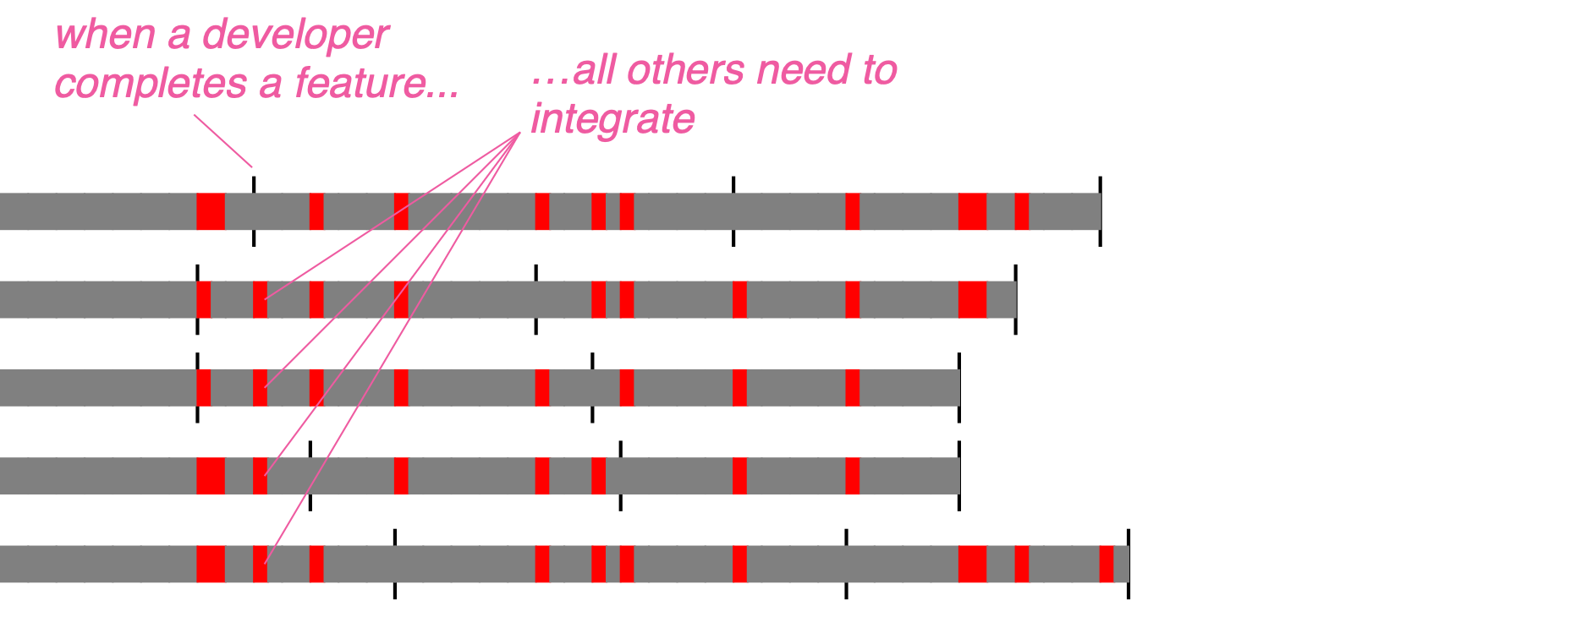
Continuous Integration
Notes:
https://martinfowler.com/bliki/UnitTest.html

Slide 37
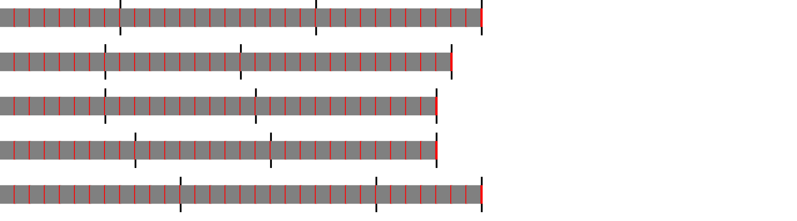
Continuous Integration
Notes:
https://martinfowler.com/bliki/UnitTest.html

Slide 38
Test Driven Development / XP
Kent Beck: Test-Driven Development: By Example, 2002 (Together with Ward Cunningham)
Extreme Programming emphasizes short feedback loops, incremental development, and code that's always working.

Slide 39
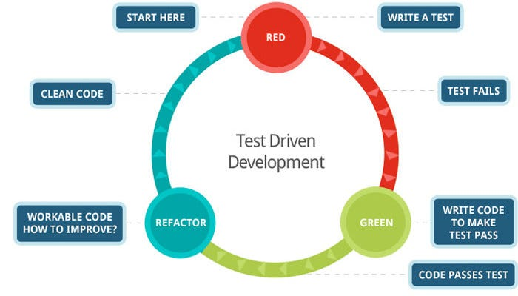
Integrating Unit Testing: Test Driven Development (TDD)

Slide 40
Test Driven Development (TDD)
For embedded systems specifically:
TDD lets you develop and verify logic on your PC, fast, without waiting for hardware.
The discipline of writing testable code forces you to separate your algorithms from your hardware abstractions — which is exactly the architecture you want anyway.
What TDD is not:
- a guarantee of correctness,
- a replacement for integration testing,
- or a rule that every line must be test-driven.
It's a tool for design feedback. Use it where it helps.

Slide 41
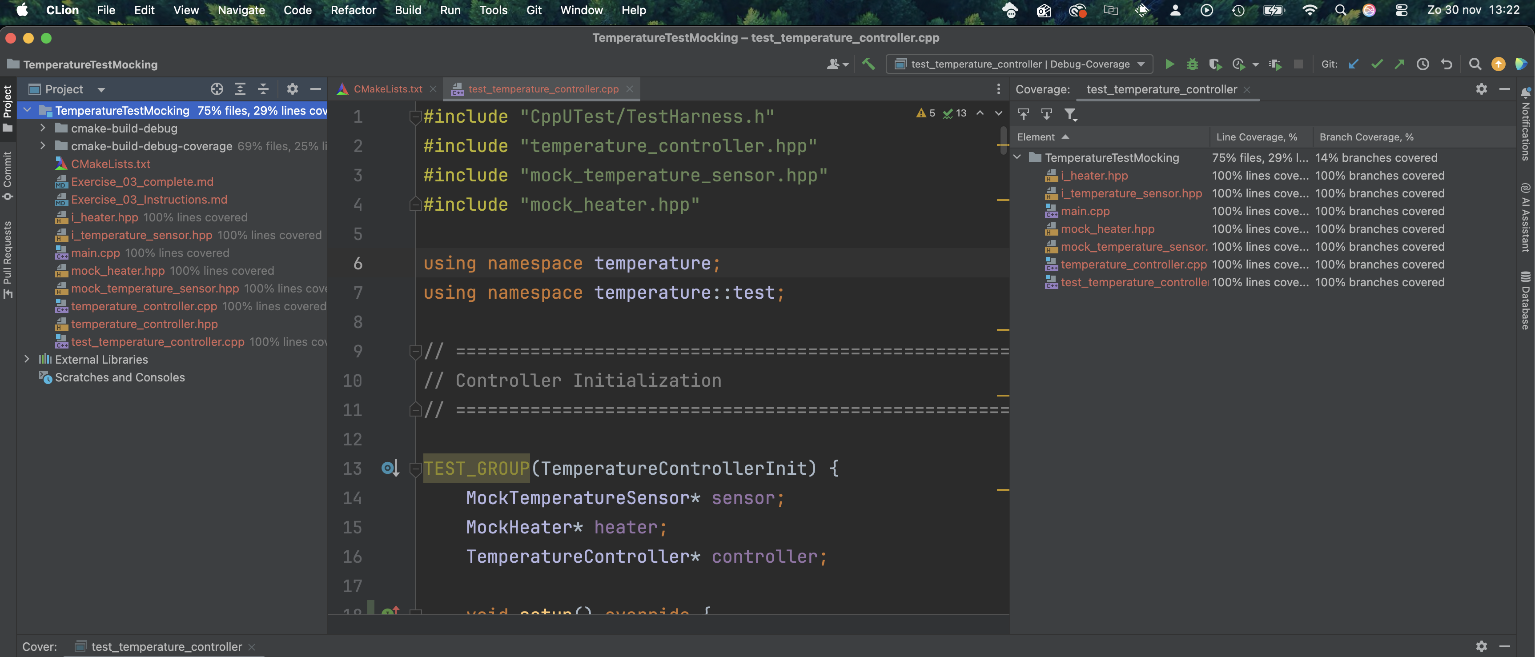
IDE influence on testing
CLion has native test coverage support
VSC use a “Coverage Gutters” extension

Slide 42
One more thing…
Back to Dijkstra.
- Testing can't prove correctness—only find bugs
The Heisenberg problem: Observing can hide bugs—instrumentation changes behavior

Slide 43
Heisenberg’s Uncertainty Principle (Quantum Mechanics)
You can't precisely measure both position and momentum of a particle simultaneously.
Observing it disturbs it.

Slide 44
Heisenberg problem in debugging
When you add instrumentation to observe your program, you change its behavior:
The Classic Symptoms
- Bug disappears when you add printf to find it
- Bug only happens in release build, not debug
- Race condition vanishes when you set a breakpoint
- Interrupt timing bug that only occurs without the debugger attached

Slide 45
Heisenberg problem of debugging
Instrumentation | How It Disturbs
printf | Takes CPU cycles, blocks on UART, changes timing by milliseconds
Breakpoint (JTAG) | Stops execution entirely—timing-sensitive code breaks
Extra variables for inspection | Changes memory layout, stack usage, cache behavior
Debug build (-O0) | Different code paths than release (-O2), different timing

Slide 46
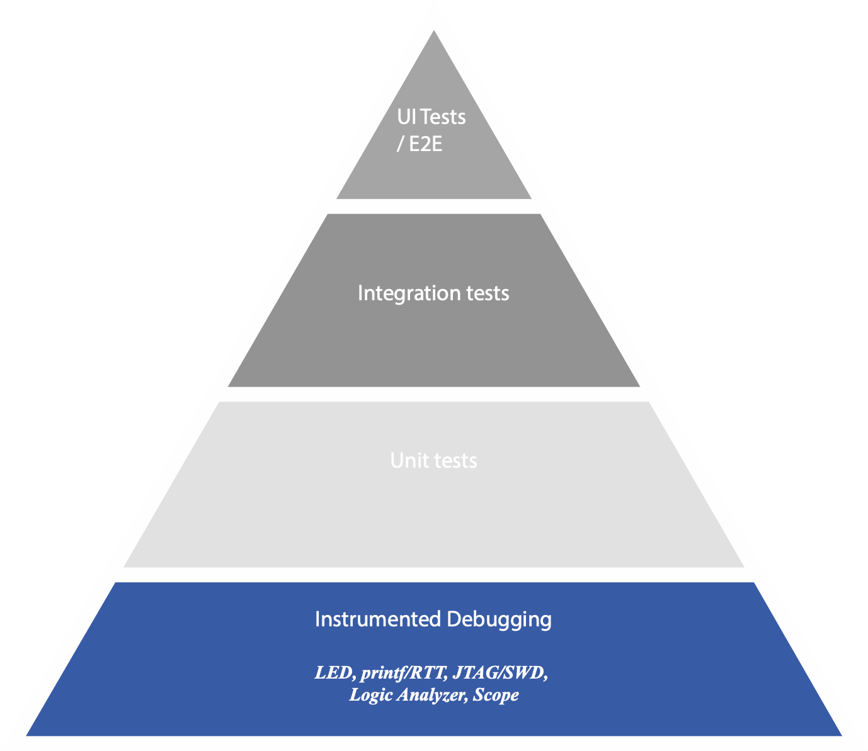
Hardware Unit Testing: Instrumented Debugging
- JTAG, SWD, JLink / ST-Link
- Ozone Debugger
- Segger SystemView
Expensive tools like:
- Lauterbach TRACE32 Debug- and Trace Solutions

Slide 47
Instrumentation Debugging
Tool | What It Shows | Strengths | Limitations
printf / RTT | Program flow, variable values | Easy, familiar | Slow, intrusive, manual interpretation
JTAG / SWD | Breakpoints, memory, registers, call stack | Non-intrusive stop, realtime inspection | Stops execution, changes timing
Logic Analyzer | Digital signal timing, protocols (SPI, I2C, UART) | Exact timing, protocol decode | External view only, no internal state
Oscilloscope | Analog signals, rise times, noise, glitches | Ground truth for electrical behavior | No software insight
Segger SystemView / Tracealyzer | RTOS task timing, events | System-level behavior over time | Requires instrumentation

Slide 48
Trace Debugging
Trace Type | ARM Core | What It Captures
ETM (Embedded Trace Macrocell) | Cortex-M3/M4/M7, Cortex-A | Full instruction trace, branch history
ITM (Instrumentation Trace Macrocell) | Cortex-M3/M4/M7 | Software-generated trace (like fast printf)
MTB (Micro Trace Buffer) | Cortex-M0+ | Lightweight trace to on-chip RAM
ETB (Embedded Trace Buffer) | Various | On-chip circular buffer for trace
Segger SystemView / Tracealyzer | RTOS task timing, events | System-level behavior over time

Slide 49
Final Message: Dijkstra + Heisenberg problem
Testing is doubly limited: it can't prove absence of bugs, and the act of testing might hide bugs that exist
State space is enormous — timing, interrupts, hardware states, race conditions
Observation is intrusive — printf/breakpoints change the system
Real environment is unpredictable — EMI, voltage sag, temperature

Slide 50
Final Message: Dijkstra + Heisenberg problem
Dijkstra said testing can only show the presence of bugs, never their absence. He's right. But showing the presence of bugs is exactly what we want—find them before the customer does.
Unit tests won't prove your code is correct. They'll catch the mistakes you make at 4pm on a Friday. That's valuable!

Slide 51
That’s all…
Any questions?

